Slide 1



E-Waste Generation Classification

Slide 2

Learning Objectives
Understand the problem of E-Waste management.
Apply deep learning for image classification.
Use transfer learning with EfficientNetV2B2.
Implement data pipelines with TensorFlow and Google Colab.
Deploy a simple web interface using Streamlit.
Evaluate model performance with confusion matrix and metrics.
GOAL
Source :
www.freepik.com/

Slide 3
Tools and Technology used
Python 3
TensorFlow & Keras
Google Colab for training
NumPy, Matplotlib, Seaborn for analysis
Scikit-learn for evaluation metrics
Streamlit for deploying the model as an interactive web app

Slide 4
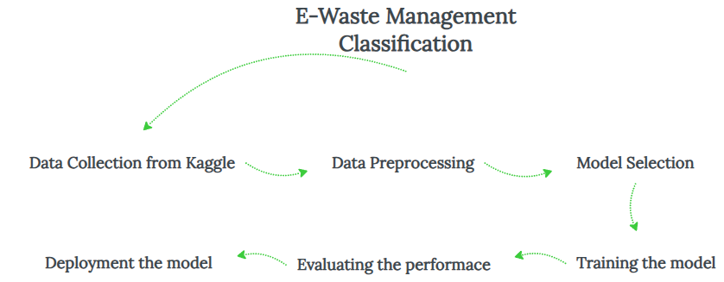
Methodology
Data Collection: Kaggle E-Waste dataset, 10 classes.
Preprocessing: Resize to 260×260, normalize, augment.
Model: Use EfficientNetV2B2 with ImageNet weights, freeze first 100 layers.
Training: Use EarlyStopping, learning rate tuning.
Evaluation: Confusion matrix, classification report.
Deployment: Streamlit interface for user testing.

Slide 5
Problem Statement:
Electronic waste is growing faster than ever, posing serious risks to our environment and human health.
E-waste includes a wide variety of items — from old phones to circuit boards — that must be sorted correctly to recycle properly.
Sorting and classifying e-waste by hand is slow, tiring, labor tedious and often inaccurate.
Poor categorization means many reusable materials are lost, and harmful substances end up polluting landfills.
There’s an urgent need for an intelligent system that can automatically identify and sort e-waste to make recycling smarter and safer.

Slide 6
Challenges :
Limited Data Volume
Overcame small dataset constraints using transfer learning and augmentation.
Fine-Tuning Deep Models
Balanced frozen layers and learning rates for optimal accuracy.
Label Confusion Issues
Learned to handle tricky lookalike classes like PCBs and keyboards.
Performance vs. Compute
Managed training time and resources effectively in Google Colab.
Key Takeaway
Deep learning for e-waste is feasible, scalable, and ready for real-world pilots.

Slide 7
Solution:
AI-Powered Sorting
Uses advanced deep learning to recognize and classify diverse e-waste items automatically.
Transfer Learning Backbone
Leverages EfficientNetV2B2 — a state-of-the-art model pretrained on millions of images — for higher accuracy even with limited data.
Seamless Data Pipeline
End-to-end pipeline built with TensorFlow and Google Colab — easy to train, test, and update.
Instant Results with Web Interface
A user-friendly Streamlit app lets anyone upload an image and get instant, reliable predictions.
Scalable & Adaptable
Designed to adapt to more categories and real-world scenarios, supporting smarter recycling centers and IoT integration.

Slide 8
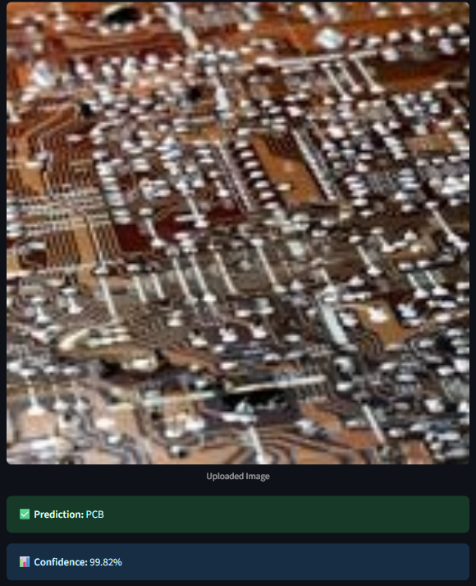
Screenshot of Output:
In this image, we observe that the uploaded image is PCB, and the model predicts it to be PCB, along with the level of confidence in its answer. It gives us an idea that there are very small chances for the uploaded image to be some other E-Waste. In some cases, the confidence can be less which increases the probability that the image might be belonging to other classes.
To access the app, click here 👉 https://aicte--internship.streamlit.app/ 👈. Test the model with multiple images and observe its accuracy and confidence.

Slide 9
Environmental Impact:
Reduces Landfill Waste
Automated sorting helps divert more electronics from landfills, lowering toxic waste.
Boosts Material Recovery
Better classification means more precious metals and reusable parts get reclaimed.
Promotes Responsible Recycling
Encourages communities to recycle old devices with confidence in proper handling.
Supports Circular Economy
Extends the lifecycle of valuable components, saving energy and raw resources.
Drives Positive Awareness
Demonstrates how AI can directly support sustainability and environmental stewardship.

Slide 10
Conclusion:
High Accuracy Achieved
Delivered ~97% test accuracy, proving deep learning is effective for e-waste sorting.
Practical Automation
Replaces tedious manual work with fast, consistent machine predictions.
Supports Sustainable Recycling
Enables better recovery of reusable materials and reduces hazardous waste.
Flexible for Industry Use
Can be integrated into recycling plants or mobile apps for on-site sorting.
Ready for Expansion
Future scope includes larger datasets, cloud deployment, and real-time edge AI solutions.
Here is the github link to the project 👉 https://github.com/GYVVishnu77/AICTE--Internship/tree/main.
The front end for the model has been made by using streamlit, hence you can also access app.py file in my github. The model (.keras) size is too big, due to which it is not possible to upload it on github. I created front end by linking it to my google drive where is saved the model.

Slide 11
Thank You

